Slide 1
Communication for work purposes
Chapter 7
Reporters:
Mark Christian I. Barro
Lemuel Lee Bandes
Mohammad Alfaiz Pala
Mark Sumile Ramos
Rayhana Saripada

Slide 2
Learning Outcomes
1
2
3
4
Create clear,
coherent, and
effective
communication materials for the workplace.
Present ideas
persuasively using appropriate
language registers,tone, facial
expressions, and
gestures.
Consider audience and context in the
preparation of each communication
output.
Produce suitable
documents with
formats required in various workplaces.

Slide 3
Introduction
Communication for work purposes - is the process of
exchanging information, ideas, and messages in a professional setting to achieve organizational goals. It involves verbal, non-verbal, and written forms of communication used to ensure
understanding, collaboration, and effective job performance.

Slide 4
Basics of Writing
Writing is an essential skill in every job, used for letters, memos, emails, reports,and more. Clear writing ensures effective communication and smooth business operations among employees, managers, and stakeholders.
Three Basics:
Purpose
Reader/Audience
Tone

Slide 5
Upward Communication
Lateral Communication
Upward communication can convey varied types of message.
The written materials are sent by subordinates to their superiors.
The materials are sent to people who are of equal level or
status; that is; between members of the same division or
department of an organization. This communication serves the
following purposes.

Slide 6
Downward Communication
Outward Communication
This is intended for workers outside the workplace. An example is letter to
the comptroller pf a company regarding financial matters.
You need to consider the diffirences in reader category that are created by
the flow of communication because they affect your communication in
many ways, particularly format.
Downward communication is very important because giving instructions is
inevitable.
This kind of communication sent by superiors to their subordinates.

Slide 7
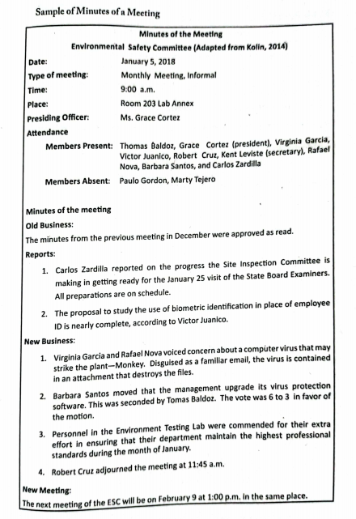
Minutes of Meetings
Minutes are official records of what happens in a meeting, including
shared information, discussions, and decisions. Minutes can be formal
(detailed, including exact motions, amendments, resolutions, and votes)
or informal (shorter, summarizing discussions).

Slide 8
GUIDELINES IN PREPARING
THE MINUTES
1. All motions and resolutions are recorded, and proponents are identified by name.
2. Seconded motions are also noted and recorded although the ones who seconded
them need not be identified.
3. Results of seconded motions must be recorded and, whether approved or
rejected, should be indicated in the minutes.
4. Headings are used to mark report sections. Titles should be all capital letters.
5. Minutes of the previous meeting should also be taken up.
6. Do not report/write verbatim (word for word) what are said. Summarize. Readers
are more interested in results.
7. Lengthy discussions, debates, and reports given should be summarized.
8. The past tense is used

Slide 9
MEMORANDUM (MEMO)
A memo, short for memorandum, is used for internal communication to record
important information. It is short, direct, and clearly states what must be done or
avoided, providing data for various functions.
1. Making announcements
2. Giving instructions
3. Clarifying a policy, procedure, or issue
4. Changing a policy or procedure
5. Alerting staff to a problem
6. Sending recommendations
7. Providing legal records
8. Calling a meeting
9. Reminding employees of corporate history, policy, and procedure.

Slide 10
MEMO PROTOCOL
Just like any other business correspondence, the memo carries the company name
and image. It should, therefore, follow the company's accepted ways in which inhouse communication is formatted, organized, written, and routed. Be guided by
these four guidelines:
Be timely – send announcements ahead of time.
Be professional – accurate, well-written, and free from errors.
Be tactful – polite and diplomatic in tone.
Send to the right person – ensure it reaches the proper recipient.

Slide 11
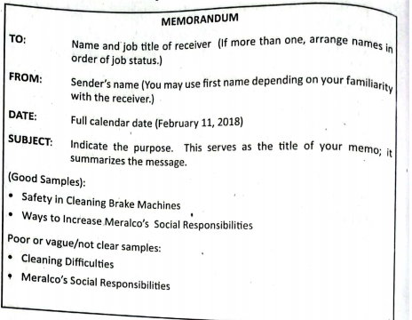
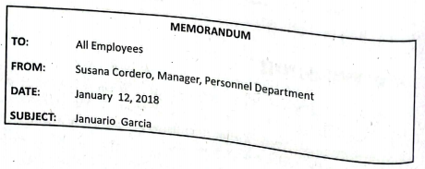
MEMO FORMAT AND PARTS
Memos vary in format and the way they are sent. Whatever the format, they should have the standard parts. The memo has basically two parts:
HEADER or identifying information and MESSAGE, aside from the word
MEMO or MEMORANDUM on top of the paper (Searles, 2014; Kolin, 2015).
1. Header - which includes four parts, as shown in the box.
2. Message - which follows the Orientation-Information Action format.

Slide 12
LETTER OF REQUEST
Business letters are mainly used for external communication, such as messages
between companies, clients, or suppliers. One common type is the letter of request,
written when seeking help, information, or clarification. According to Kolin (2015),
writing a request letter should follow specific guidelines to ensure clarity and
professionalism.
Guidelines in writing letter of request:
1. Direct/address your letter to the right person.
2. State who you are and your work title and why you are writing.
3. Indicate your reason for requesting help and, if applicable, mention who suggested
you write.
4. State your questions briefly and clearly:
5. Indicate exactly when you need the information, but allow sufficient time
6. Offer to forward a copy of your report, article, or paper in gratitude for the
anticipated help.
7. Thank the reader for helping

Slide 13
TYPES OF SHORT REPORTS

Slide 14
SHORT REPORTS
A short report may be oral or written, such as in a memo, letter,
or email, and is meant to inform the reader about a specific
topic. It is an organized presentation of relevant data that a
company or agency deals with in its operations.

Slide 15
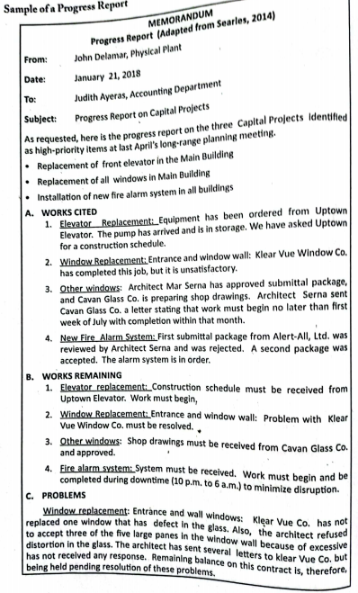
PROGRESS
REPORT
A progress report informs management about the status of an ongoing project,
including what has been done, what is in progress, and what will be done by a certain date. When timely and accurate, it helps management adjust plans, meet deadlines,
and avoid unnecessary problems or expenses.

Slide 16

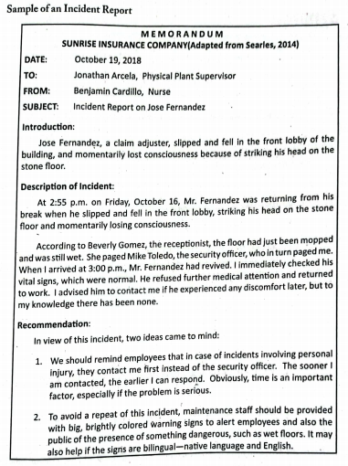
An incident report records unexpected events that cause harm to people, property, or operations, such as accidents, injuries, or breakdowns. It is usually written by the person involved or the one in charge to explain the circumstances of the incident.

Slide 17
PROJECT PROPOSAL
A project proposal is a document written to persuade someone to follow or accept a specific course of action. It may propose (a) a change of process or policy, (b) a solution to a problem, (c) the purchase of a product or service,
(d) the pursuit of an activity, or (e) research.

Slide 18
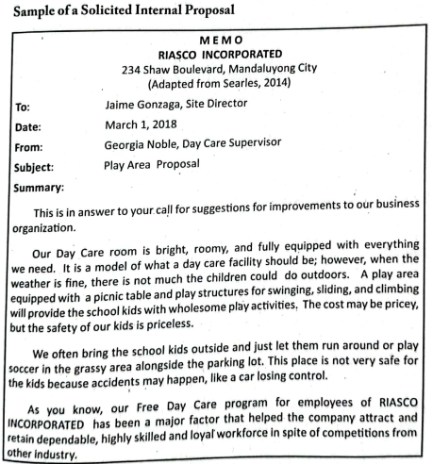
SOLICITED INTERNAL PROPOSAL
A Solicited Internal Proposal is a proposal written within an organization in response to a specific request from management or another department. It presents solutions, plans, or recommendations to meet a stated need or problem. The primary purpose of an internal proposal is to offer realistic, constructive plans to
help the management run the business efficiently and effectively.

Slide 19
THANK YOU
FOR LISTENING!

